Slide 1
LIVE CHROMA KEY VIDEO TESTING

Slide 2
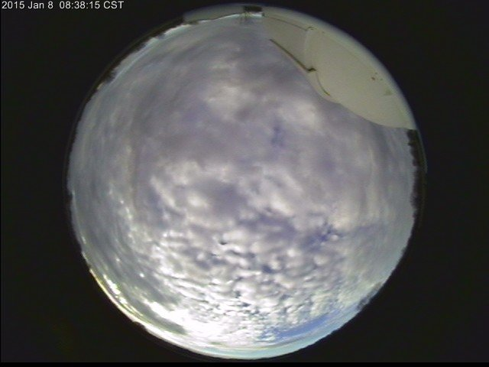
DOUGLAS OBSERVATORY – WARRENSBURG, MO
LIVE

Slide 3
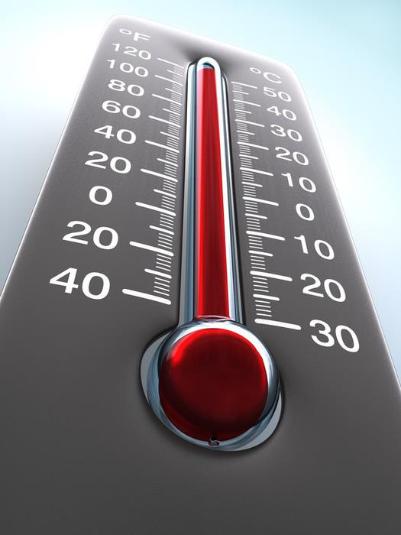
ALMANAC
HIGH
LOW
18
-3
YESTERDAY
38
20
NORMAL
71
-10
RECORD
2003
1979

Slide 4
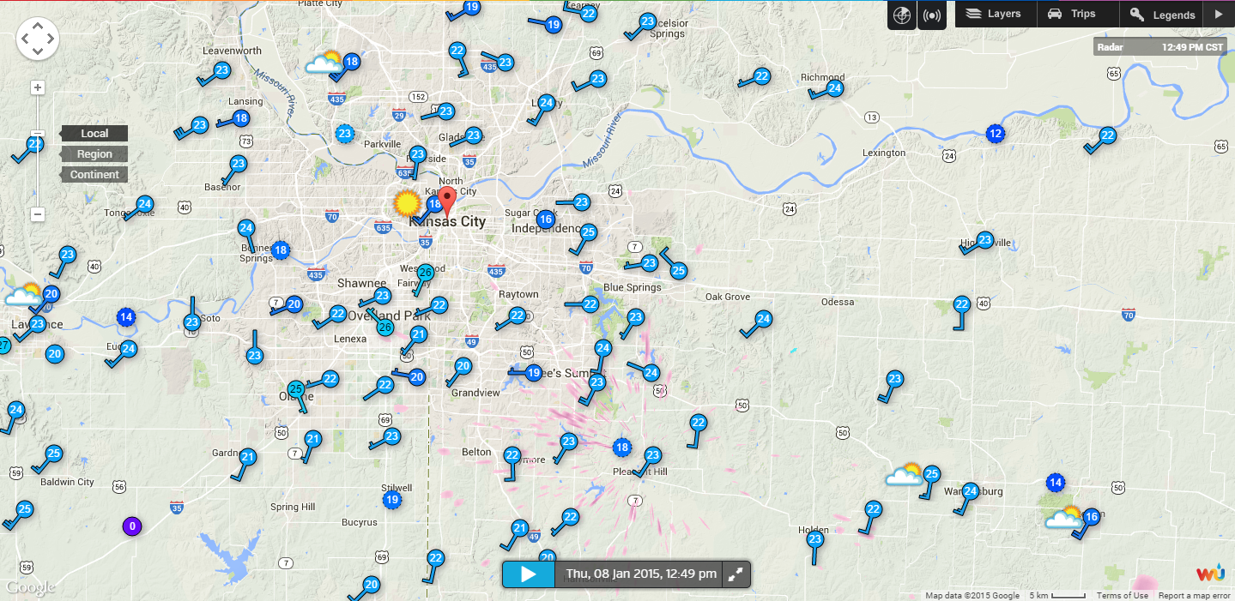
CURRENT CONDITIONS

Slide 5
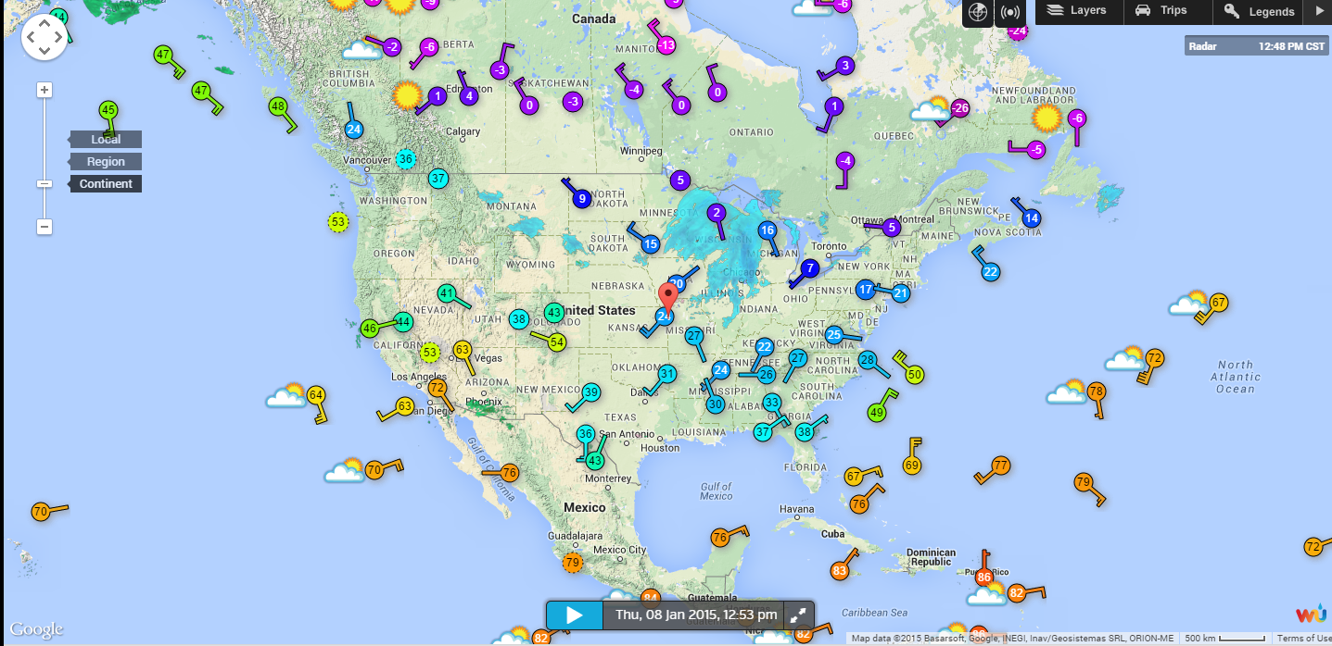
CURRENT CONDITIONS

Slide 6
THURSDAY PLANNER
NOON
4 PM
8 PM
19
28
26

Slide 7
7-DAY FORECAST
THU
FRI
SAT
SUN
MON
TUE
WED
30%
28
15
25
34
33
31
29
-2
7
2
22
25
20
15

Slide 8
NEWS
∞
CHANNEL

Slide 9
12:00
105°

Slide 10
12:00
105°

Slide 11
TONIGHT AT 9PM
MORE INFO HERE

Slide 12
BREAKING NEWS
A MASSIVE FIRE BROKE OUT
LIVE FROM THE LOCAL MARKET

Slide 13
BREAKING NEWS
A MASSIVE FIRE BROKE OUT

Slide 14
COMING UP
A MASSIVE FIRE BROKE OUT

Slide 15
LIVE

Slide 16
BREAKING NEWS

Slide 17
EARLIER TODAY

Slide 18
SPORTS
REPORT

Slide 19
WEATHER
UPDATE

Slide 20
BREAKING
NEWS

Slide 21
∞
NEWS CHANNEL

Slide 22
∞
NEWS AT 5:00

Slide 23
∞
NEWS AT 6:00

